Slide 1
REFRIGERATION
Ramu Rajendran

Slide 2
Introduction
Process of maintaining a space/system at a temperature below the surrounding temperature.
Achieved by removing heat energy from the space.
Accomplished by natural methods or artificial methods.
Natural – By melting ice in the space to be cooled.
Artificial – Mechanical refrigeration.

Slide 3
Applications
Industrial – Processing of food, farm crops, photographic materials, petroleum and other chemical products, treatment of concrete for dams, processing in textile mills, printing works etc.
Preservation of perishable goods – Storage and transportation of food stuff. (Fish, fruits, vegetables, meats, dairy products, poultry products etc.)
Providing comfortable environment – Comfort air conditioning of residences, hospitals, theatres, offices etc.
Cryogenic applications – (less than -153 deg C) Maintain Liq N, Liq O, Li He etc. for different applications. (Industrial, Rocket propulsion applications)

Slide 4
Unit of Refrigeration
Refrigerating effect is the rate of heat absorbed from a body/space to be cooled.
Standard unit of refrigeration is ton refrigeration or simply ton.
One Ton refrigeration is defined as, the rate of heat transfer equivalent to absorption of latent heat of fusion of one ton of ice at 0 deg C in 24 hours.
MKS unit – kCal per hour
(1 Ton = 3.5167 kJ/sec; 1 kCal = 4.184 kJ)

Slide 5
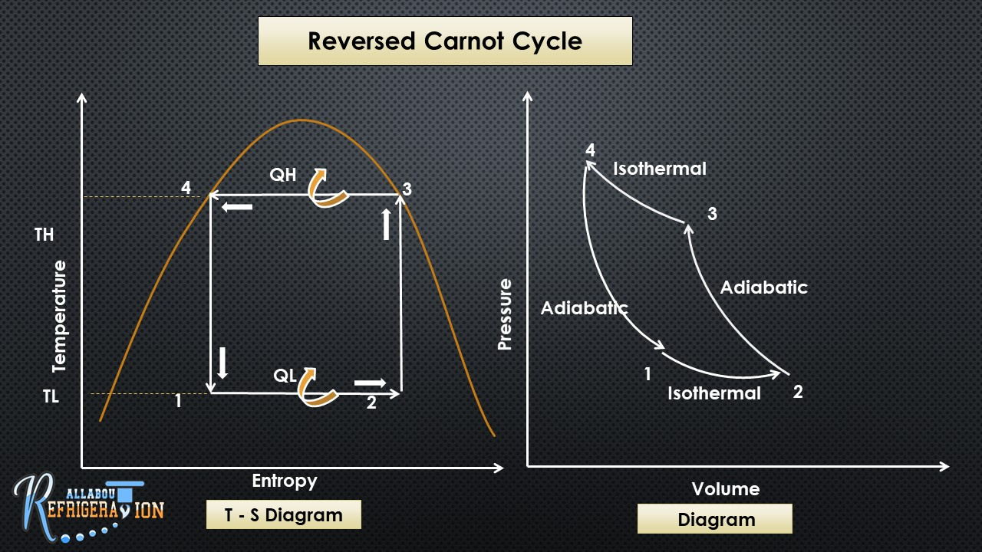

Slide 6
Carnot Cycle (Work producing) is a reversible process i.e. all the processes in a Carnot cycle are reversible.
If all the processes are reversed in the same order, we obtain a Reversed Carnot cycle (Work consuming).
The processes in a reversed carnot cycle are isothermal heat addition (1-2), adiabatic compression (2-3), isothermal heat rejection (3-4), adiabatic expansion (4-1).
A reversed carnot cycle absorbs heat from a low temperature (1-2 process) and rejects heat to a high temperature (3-4 process).
To do this we need to give work input. (adiabatic compression)(process 2-3).
A reversed carnot cycle gives the basic framework of refrigeration, even though it cannot be obtained practically.
Reversed carnot cycle is also an ideal cycle. (refrigeration cycle).

Slide 7
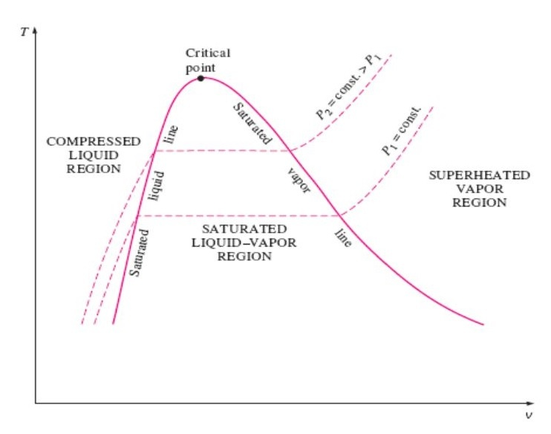
Vapor Dome
Vapor Dome – Region in T-S or P-V diagram in which liquid is in process to become steam and vice versa, at a specified pair of saturation pressure and saturation temperature.

Slide 8
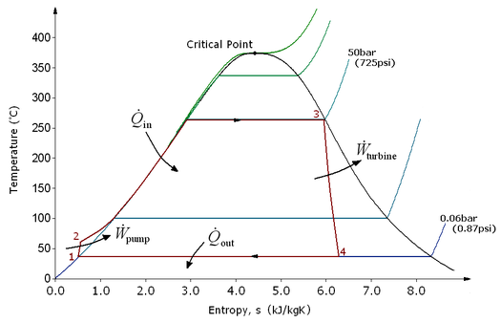
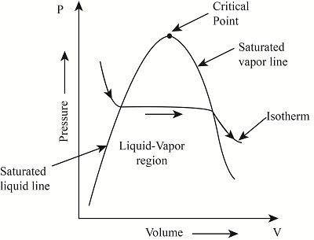

Slide 9
Vapor dome is the region in p-v diagram, T-S diagram etc. where the phase transformation between liquid and vapor takes place.
The material inside the Vapor dome is a mixture of liquid and vapor, called the wet vapor.
The left hand side of vapor dome is saturated liquid line, the points on and beyond which represent states of pure liquid. The region in the left side of vapor dome is called compressed liquid region.
The right hand side of vapor dome, called saturated vapor line, represents states of pure vapor. The region to the right of it is called superheated vapor.
The point where saturated liquid line and saturated vapor line meets is called critical point. At pressures and temperatures higher than critical pressure and critical temperature liquid just flashes to vapor phase and vice versa.

Slide 10
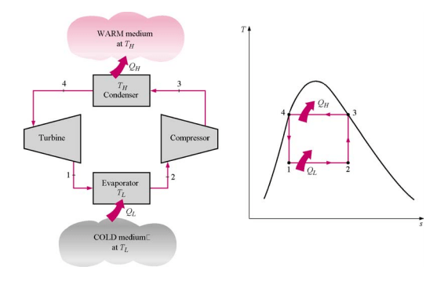
Working of Reversed Carnot Cycle

Slide 11
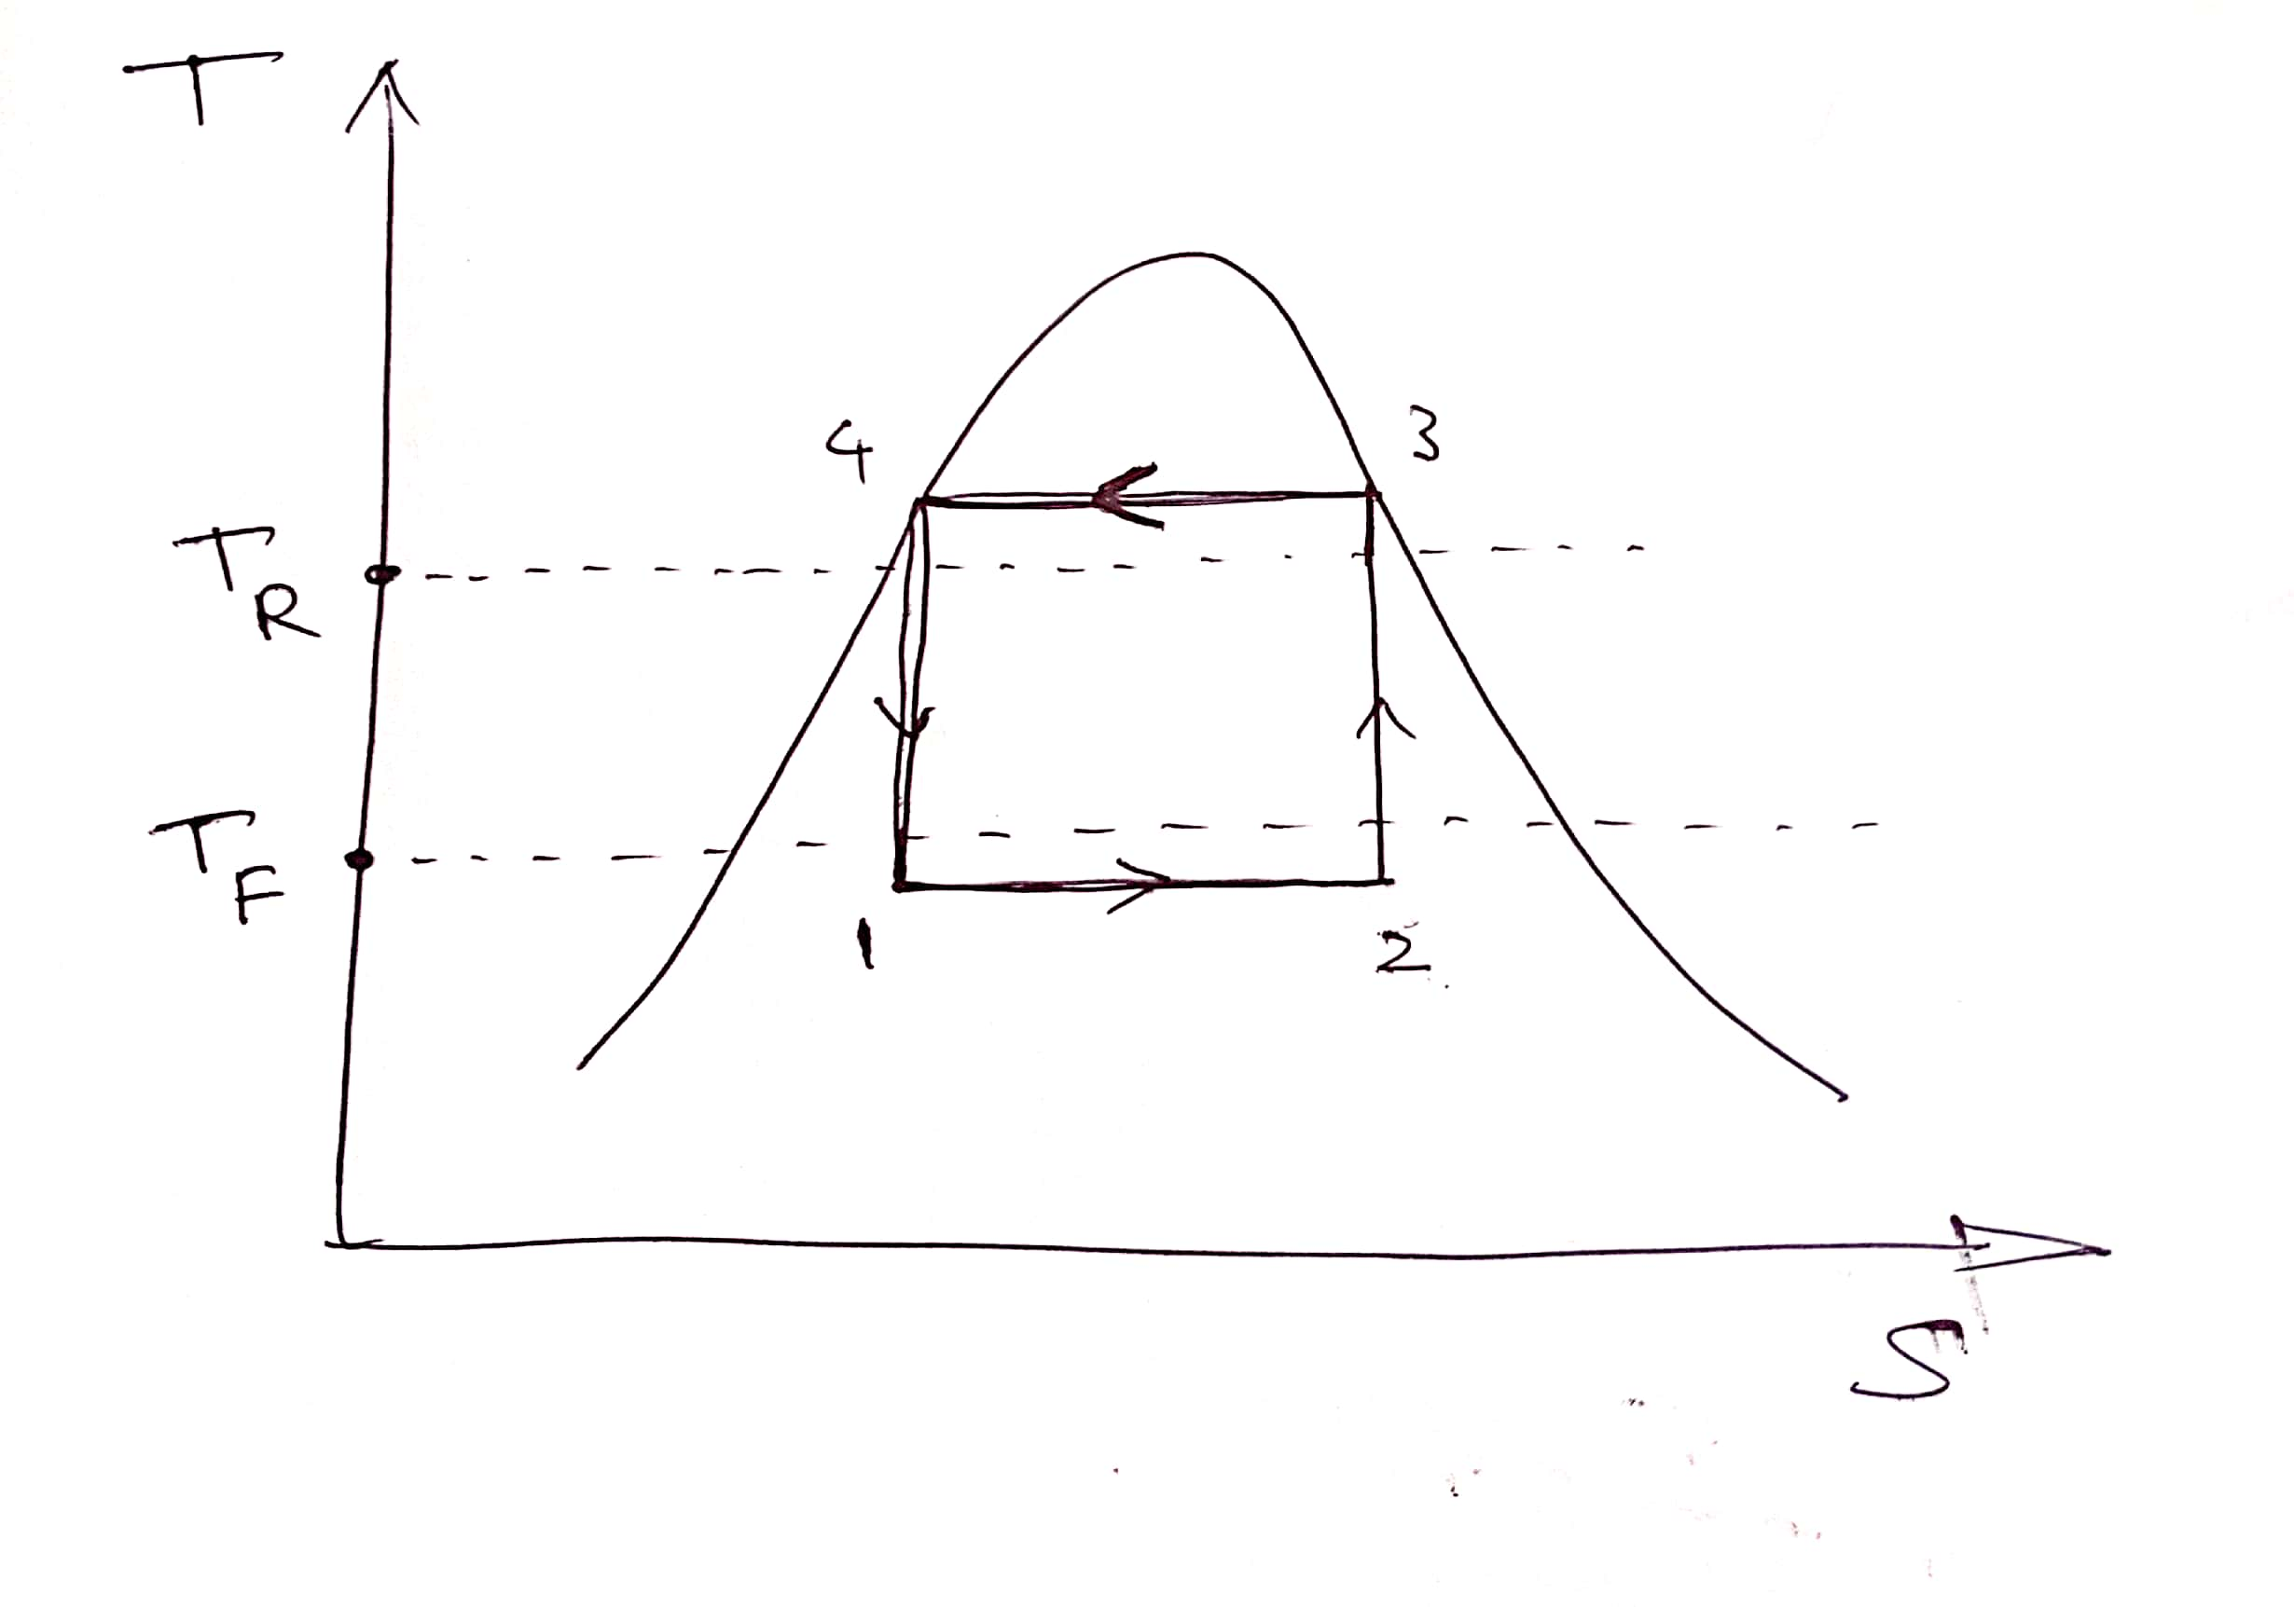
REVERSED CARNOT CYCLE
TR – Room temperature
TF – Freezer Temperature

Slide 12
The working fluid known as the refrigerant is circulated inside the refrigerator. It passes through different components of the refrigerator as explained below.
Evaporator – In a refrigerator evaporator is exposed to the freezer compartment. Refrigerant entering the evaporator is in a state of low pressure and low temperature (temp. lower than freezer temp). Therefore when the refrigerant inside the evaporator comes in contact with the freezer, it absorbs heat from the high temperature freezer compartment. Refrigerant vaporizes itself in the process. The process is isobaric as well as isothermal
Compressor – From evaporator the refrigerant flows into the compressor. Inside the compressor the refrigerant is compressed to a state of high pressure and high temperature. We need to give work input to the compressor. The process is a reversible adiabatic process (isentropic process). At the end of the process refrigerant attains a state of saturated vapor.

Slide 13
Condenser – From the exit of compressor the refrigerant moves into condenser, which is exposed to the atmospheric air. The state of the refrigerant inside the condenser is at a higher temperature than the atmospheric temperature. Therefore it rejects heat to the surrounding air. This process is an isothermal heat rejection process. The refrigerant condenses itself down to a state of saturated liquid.
Turbine – From the condenser, the refrigerant reaches the turbine, in which the pressure and temperature of the refrigerant is reduced to a levels required inside the evaporator. In the turbine we get back some portion of the work given into the compressor. This process is also a reversible adiabatic process.

Slide 14
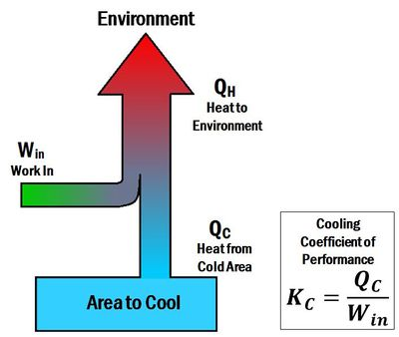
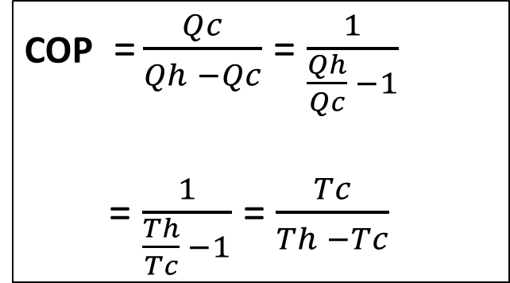
COP (Coefficient of Performance)
COP represents the effectiveness of a refrigerator. It measures the performance of a refrigerator.
Ratio of desired effect to work consumed to produce desired effect.
COP of Reversed Carnot Cycle
COP = $\frac{Qc}{Qh −Qc}$ = $\frac{1}{\frac{Qh}{Qc} −1}$
= $\frac{1}{\frac{Th}{Tc} −1}$ = $\frac{Tc}{Th −Tc}$

Slide 15
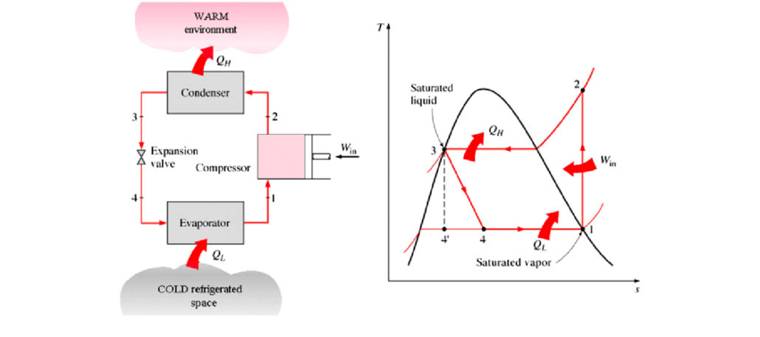
Vapor Compression System

Slide 16
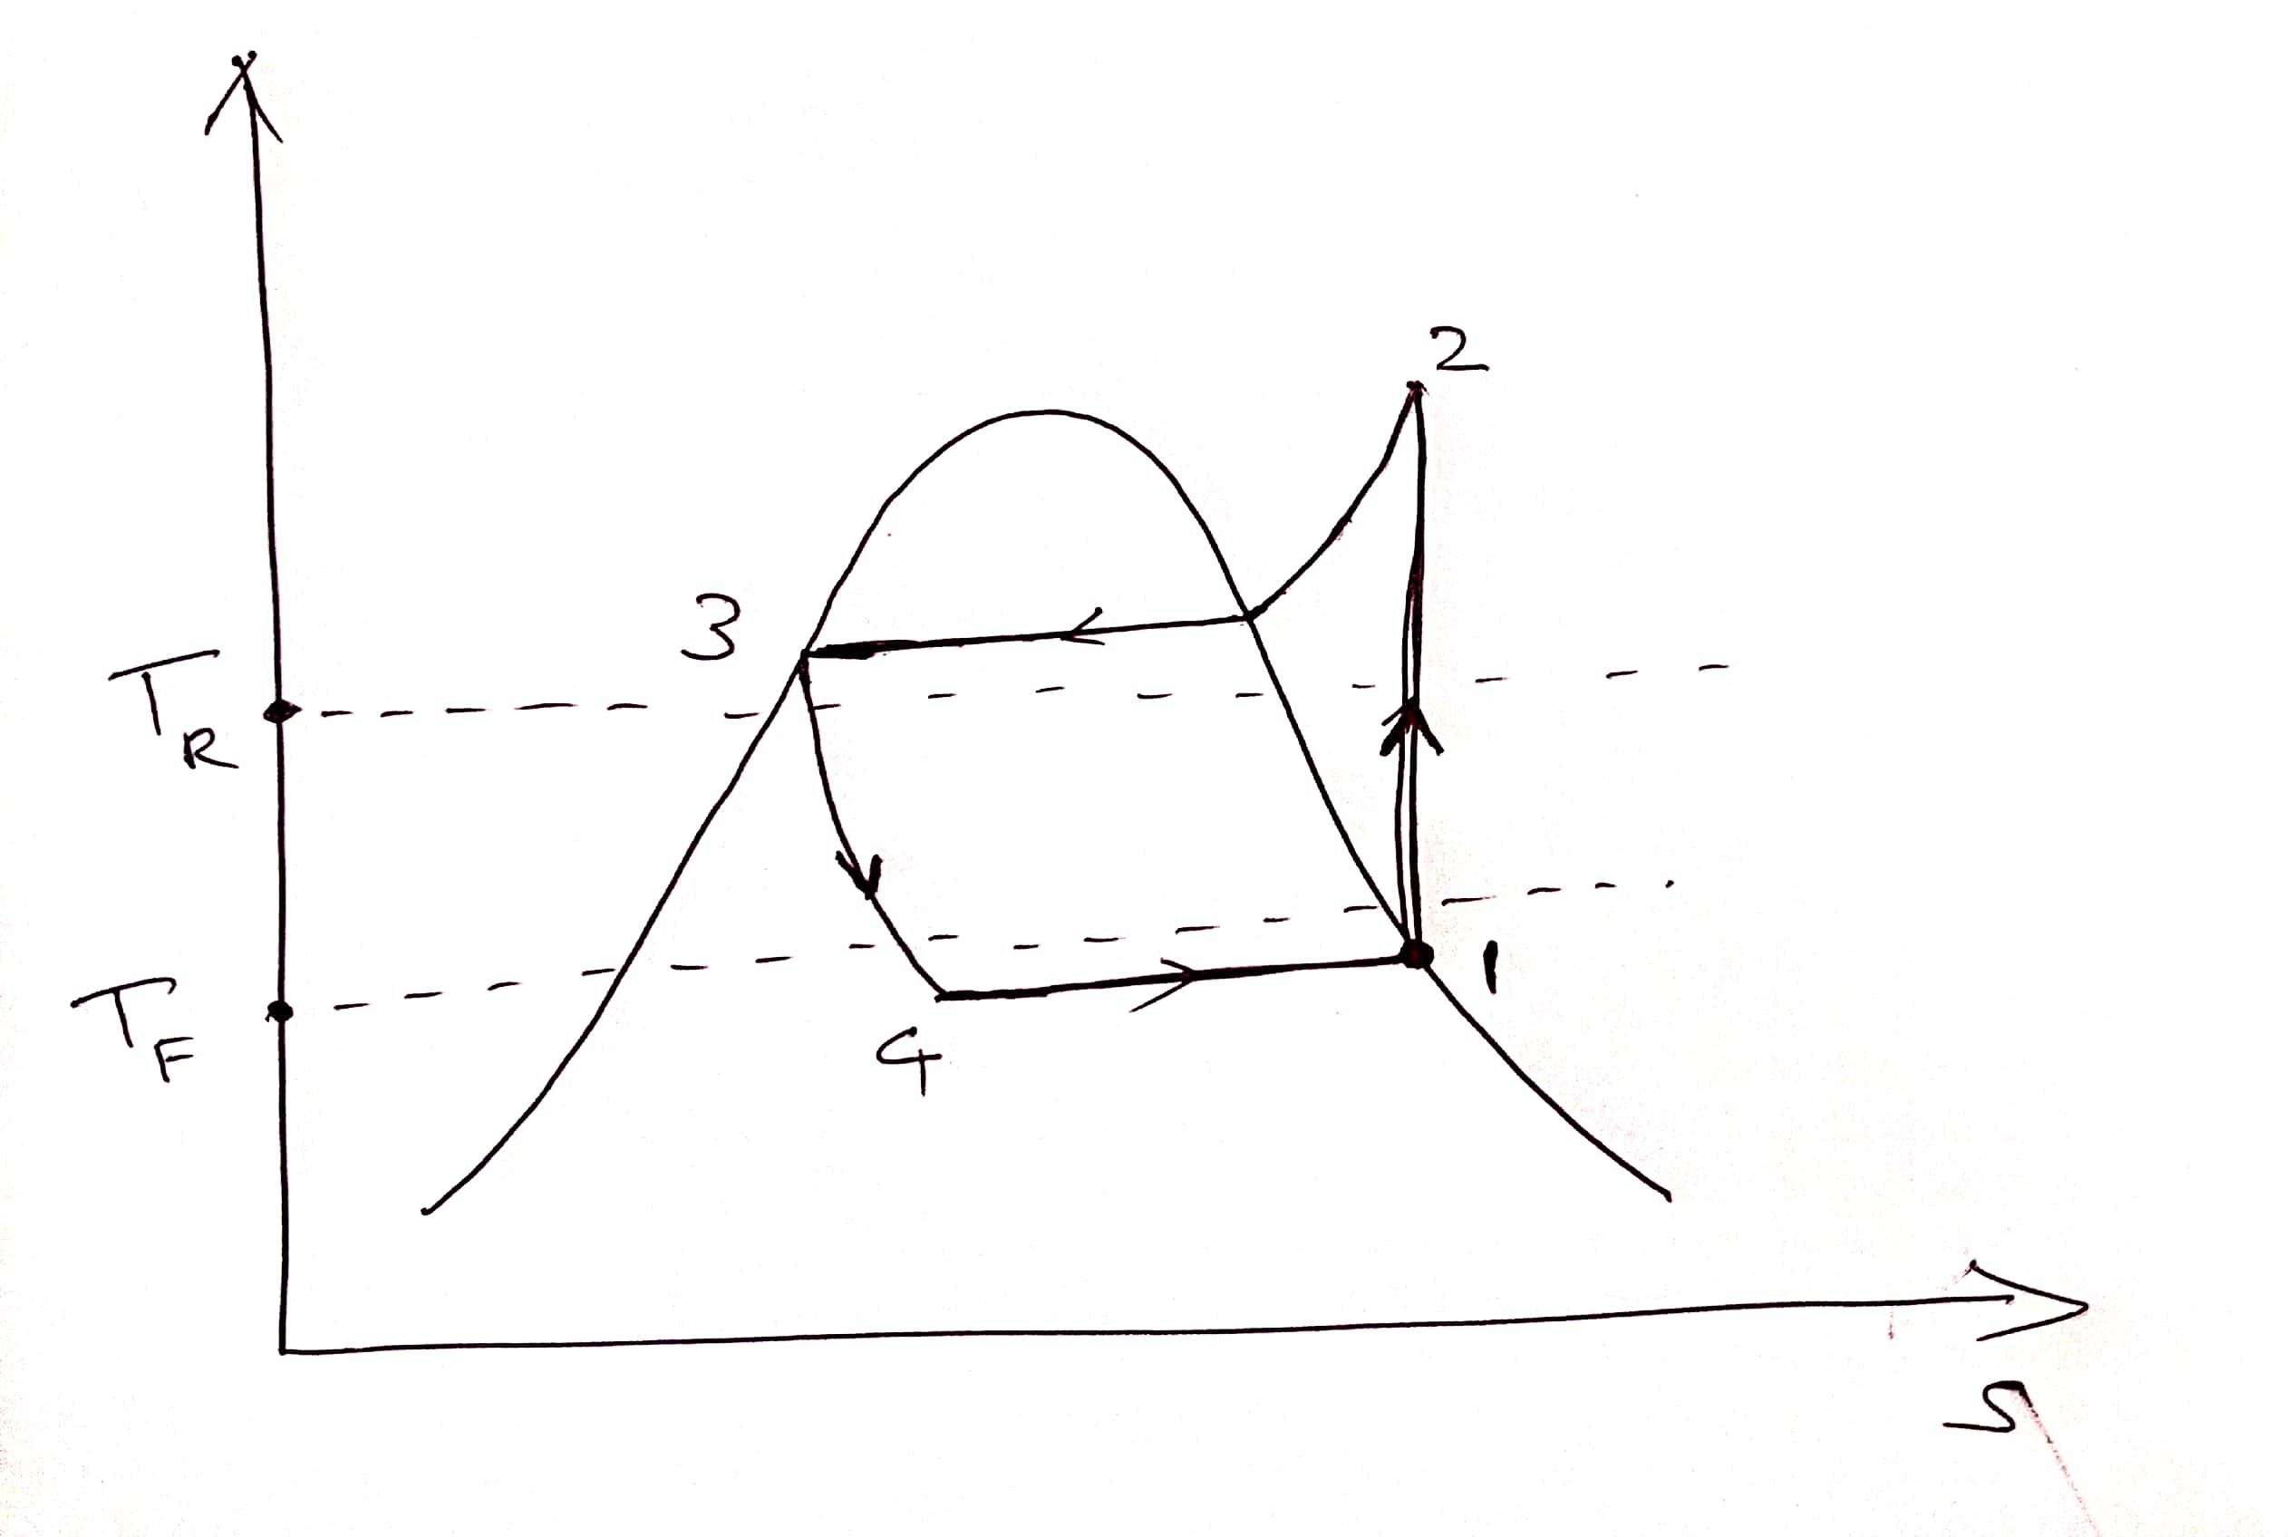
VAPOR COMPRESSION REFRIGERATION
TR – Room temperature
TF – Freezer Temperature

Slide 17
The working fluid known as the refrigerant is circulated inside the refrigerator. It passes through different components of the refrigerator as explained below.
Evaporator – In a refrigerator evaporator is exposed to the freezer compartment. Refrigerant entering the evaporator is in a state of low pressure and low temperature (temp. lower than freezer temp). Therefore when the refrigerant inside the evaporator comes in contact with the freezer, it absorbs heat from the high temperature freezer compartment. Refrigerant vaporizes itself in the process and attains a state of saturated vapor. The process is isobaric as well as isothermal heat addition process.
Compressor – From evaporator the refrigerant flows into the compressor. Inside the compressor the refrigerant is compressed to a state of high pressure and high temperature. We need to give work input to the compressor. The process is a reversible adiabatic process (isentropic process). At the end of the process refrigerant attains a state of superheated vapor.

Slide 18
Condenser – From the exit of compressor the refrigerant moves into condenser, which is exposed to the atmospheric air. The state of the refrigerant inside the condenser is always at a higher temperature than the atmospheric temperature. Therefore it rejects heat to the surrounding air. This process is an isobaric heat rejection process. The refrigerant condenses itself down to a state of saturated liquid.
Expansion Valve – Expansion valve or throttling valve, is constricted/narrow diameter passage. When refrigerant flows through the expansion valve, its pressure and temperature reduces. Due to considerable amount of friction, the process is irreversible (Denoted by a curved dotted line). Therefore it is adiabatic, but not isentropic.

Slide 19
Refrigerants
Working substance in a refrigerator.
Carries heat from cold place to a hot place.
It changes from liquid to vapor state when absorbing heat and condenses to liquid while liberating heat.
Most common refrigerants are ammonia, fluorinated hydrocarbons (Freons), Carbon Dioxide, Sulphur dioxide, air, water etc.

Slide 20
Desirable properties of a refrigerant
Condensing and evaporating pressure should be above atmospheric pressure, to avoid leakage of air into the system.
Critical temperature should be high enough compared to condensing temperature, to reduce power requirements.
Freezing temperature should be very low, to avoid freezing and choking.
Latent heat of vaporization should be high to reduce the quantity of refrigerant used.
Specific volume should be low to reduce the size of the compressor.
Viscosity should be low to reduce pressure drops in pipes.

Slide 21
Thermal conductivity should be high so that heat transfer is done fast.
Stability – Should be chemically stable.
Should not be inflammable.
Should be non-corrosive.
Should not be toxic.
Should be easy to detect leakage.
Should have good oil solubility so that lubrication of the compressor is effective.
Should have high electric resistance.
Should be cheap and easily available.

Slide 22
Air Conditioning
Air conditioning involves supplying and maintaining a desired internal condition irrespective of external conditions.
It involves control of air purity, air motion, temperature and humidity of air inside a space.
The conditions needed may be different for different applications.

Slide 23
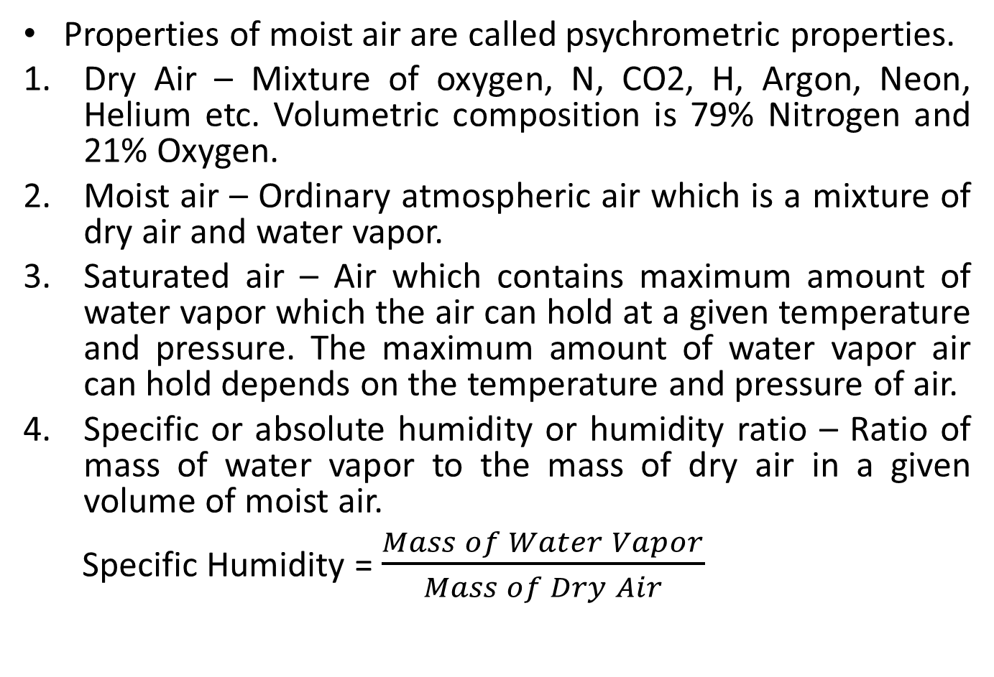
Psychrometric Properties
Properties of moist air are called psychrometric properties.
Dry Air – Mixture of oxygen, N, CO2, H, Argon, Neon, Helium etc. Volumetric composition is 79% Nitrogen and 21% Oxygen.
Moist air – Ordinary atmospheric air which is a mixture of dry air and water vapor.
Saturated air – Air which contains maximum amount of water vapor which the air can hold at a given temperature and pressure. The maximum amount of water vapor air can hold depends on the temperature and pressure of air.
Specific or absolute humidity or humidity ratio – Ratio of mass of water vapor to the mass of dry air in a given volume of moist air.
Specific Humidity = $\frac{Mass of Water Vapor}{Mass of Dry Air}$

Slide 24
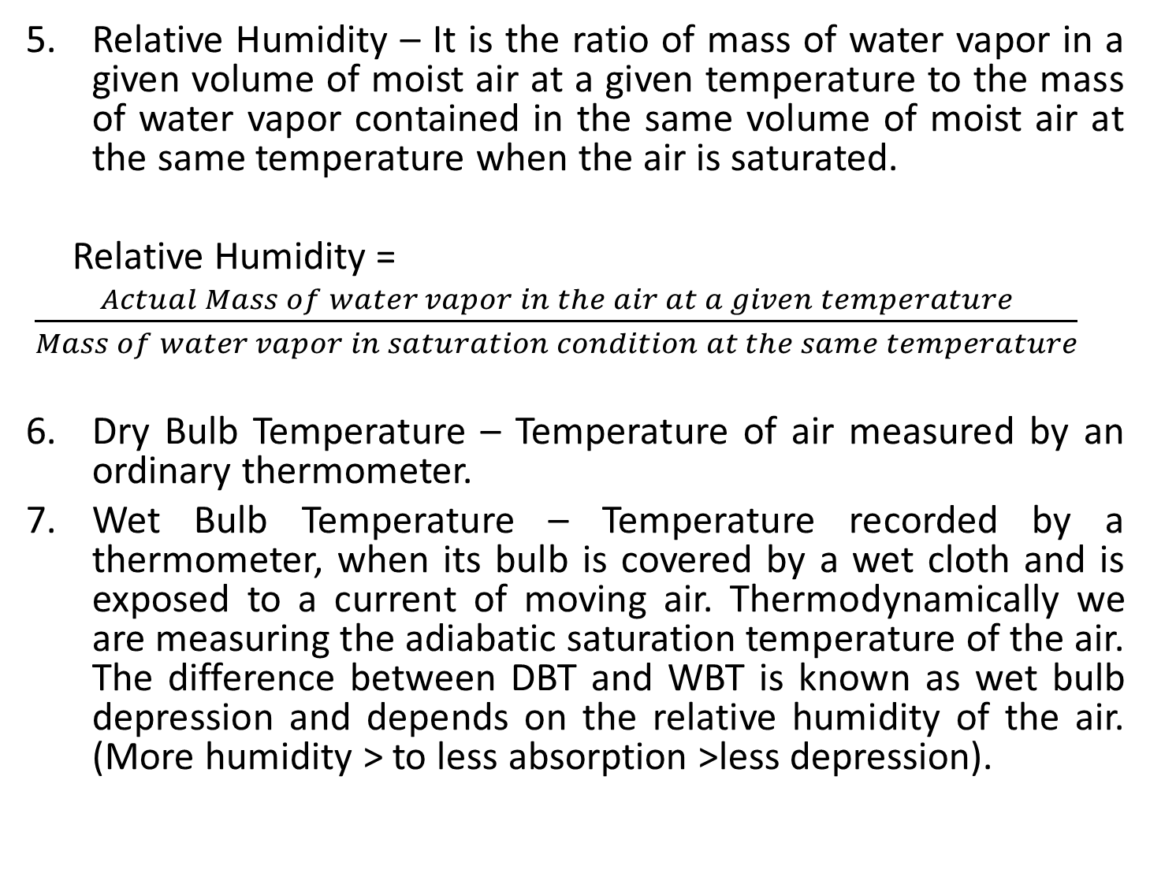
Relative Humidity – It is the ratio of mass of water vapor in a given volume of moist air at a given temperature to the mass of water vapor contained in the same volume of moist air at the same temperature when the air is saturated.
Relative Humidity =
$\frac{Actual Mass of water vapor in the air at a given temperature}{Mass of water vapor in saturation condition at the same temperature}$
Dry Bulb Temperature – Temperature of air measured by an ordinary thermometer.
Wet Bulb Temperature – Temperature recorded by a thermometer, when its bulb is covered by a wet cloth and is exposed to a current of moving air. Thermodynamically we are measuring the adiabatic saturation temperature of the air. The difference between DBT and WBT is known as wet bulb depression and depends on the relative humidity of the air. (More humidity > to less absorption >less depression).

Slide 25
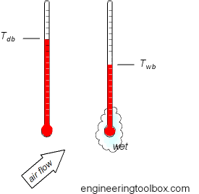
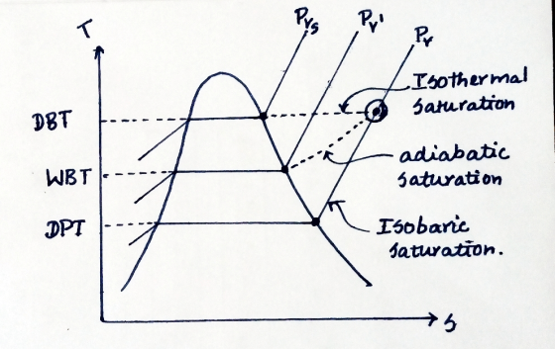
8. Dew Point Temperature – It is the temperature at which the condensation of moisture begins when the air is cooled at constant pressure. The difference between DBT and DPT is known as dew point depression.

Slide 26
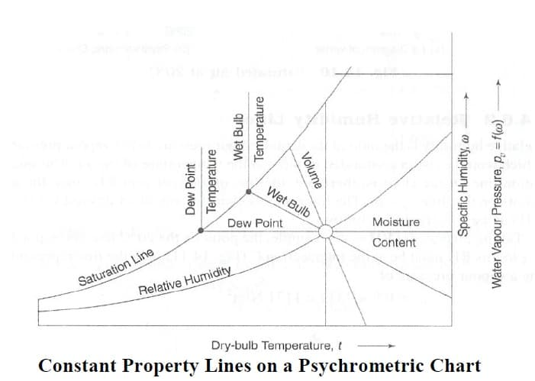
Psychrometric Chart
It is the graphical representation of different psychrometric properties and their interconnection. If we know 2 of the psychrometric properties we can find all other psychrometric properties using a psychrometric chart (or using equations).

Slide 27
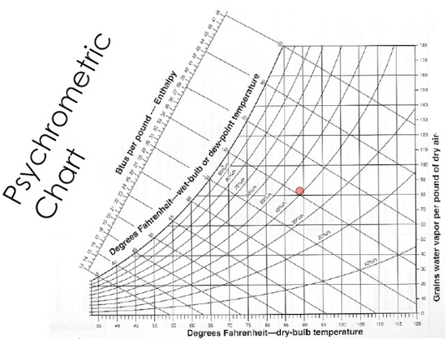

Slide 28
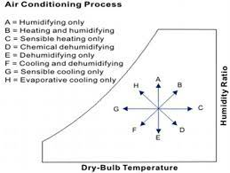
Representation of different psychrometric processes in the psychrometric chart

Slide 29
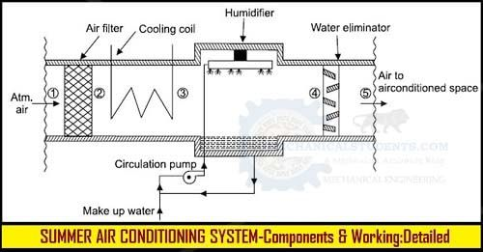

Slide 30
Summer Air-conditioning for hot and dry condition
Air is initially passed through an air filter to remove any dust or dirt particles.
From filter, air moves to contact a cooling coil whose temperature is maintained at a temperature below the DBT (and above DPT). Here the temperature of the air stream goes down.
After this, the air is passed through a humidifier in which water is sprayed into the air stream. The water absorbs heat from the air (due to which the temperature of the air stream reduces further) and vaporizes itself to join the air stream. Humidity of the air increases due to addition of water vapor.
Finally the air is passed through a water eliminator to remove any water particles before being flown out to the air conditioned space.

Slide 31
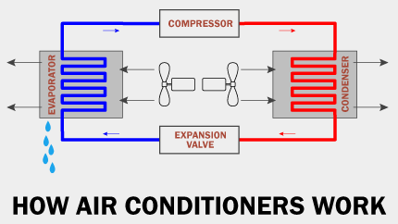
Unit Air Conditioner

Slide 32
It works on the basis of vapor compression refrigeration cycle. (See Vapor Compression Refrigeration for working)
A unit air conditioner has two parts. The one having evaporator is placed inside the room to be cooled. The other part having condenser is placed outside the room, preferably exposed to outside environment where the heat is supposed to be rejected.
Blowers or fans are used to enhance air flow through evaporator and condenser, so that heat transfer rate increases.

Slide 33
Central Air Conditioner
When cooling capacity is 25 tons or more.
When the air flow is more than 5 m3/hr.
When different zones in a building are to be air conditioned.
All components of the system are installed in a separate central room.
Conditioned air is distributed through ducts.

Slide 34
END

